Slide 1
Touch and proprioception
By: Nicole Phillips

Slide 2
Learning Objectives
Differentiate somatosensory receptors and their functional importance
Describe the anatomical pathways that convey sensory input from the body and face to the brain
Predict the location of damage from presentation of clinical symptoms

Slide 3
Sensory Receptors
Sensory receptor organs are organs specialized to detect a certain stimulus.
Receptor cells within the organ convert stimuli into action potentials (transduction).
Signal detection
Signal transduction
Signal transmission
1
2
3

Slide 4
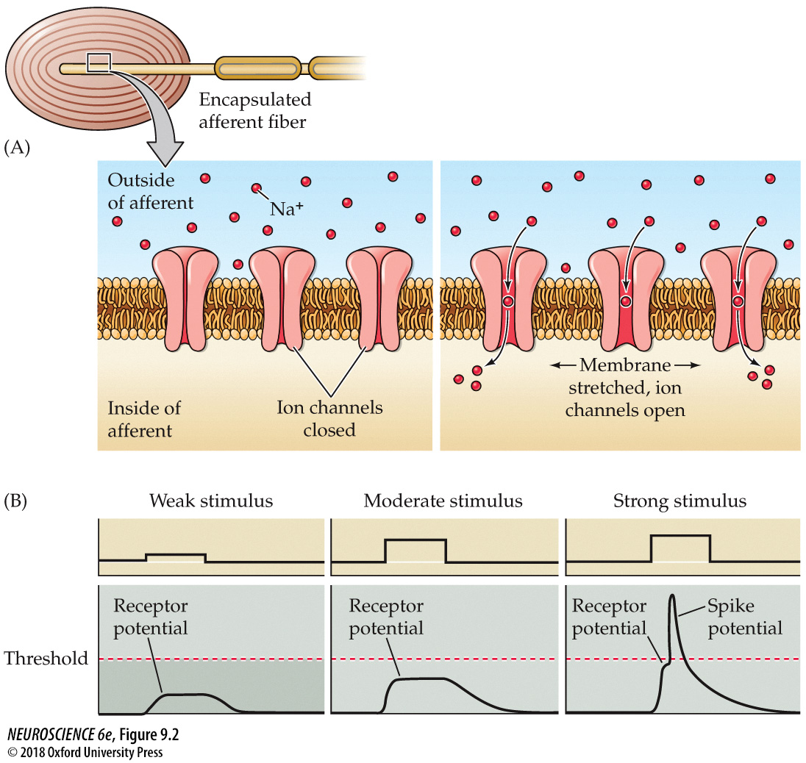
Receptor Potentials
Passive electrotonic potentials
  Typically depolarizing
RPs can summate similar to PSPs
May trigger an AP

Slide 5
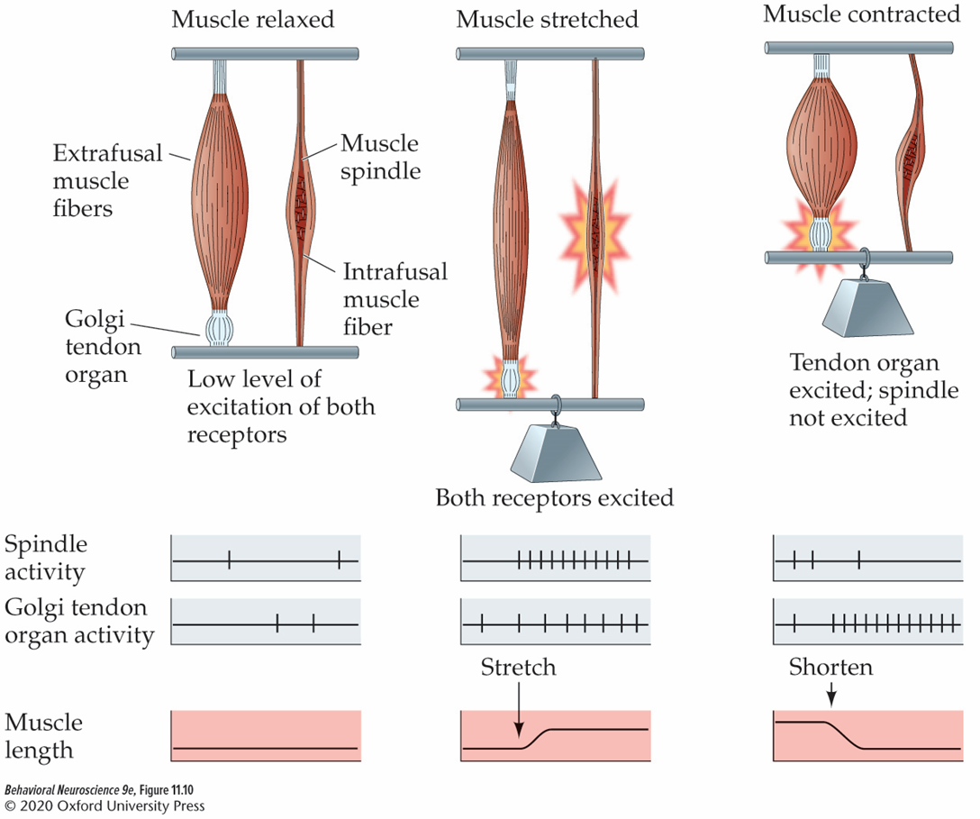
Proprioceptors
Proprioception: perception of body movements and positions in space.
Proprioceptive receptors:
  Muscle spindles monitor muscle length.
  Golgi tendon organs monitor muscle tension.
  Joint receptors: joint movement and pain.

Slide 6
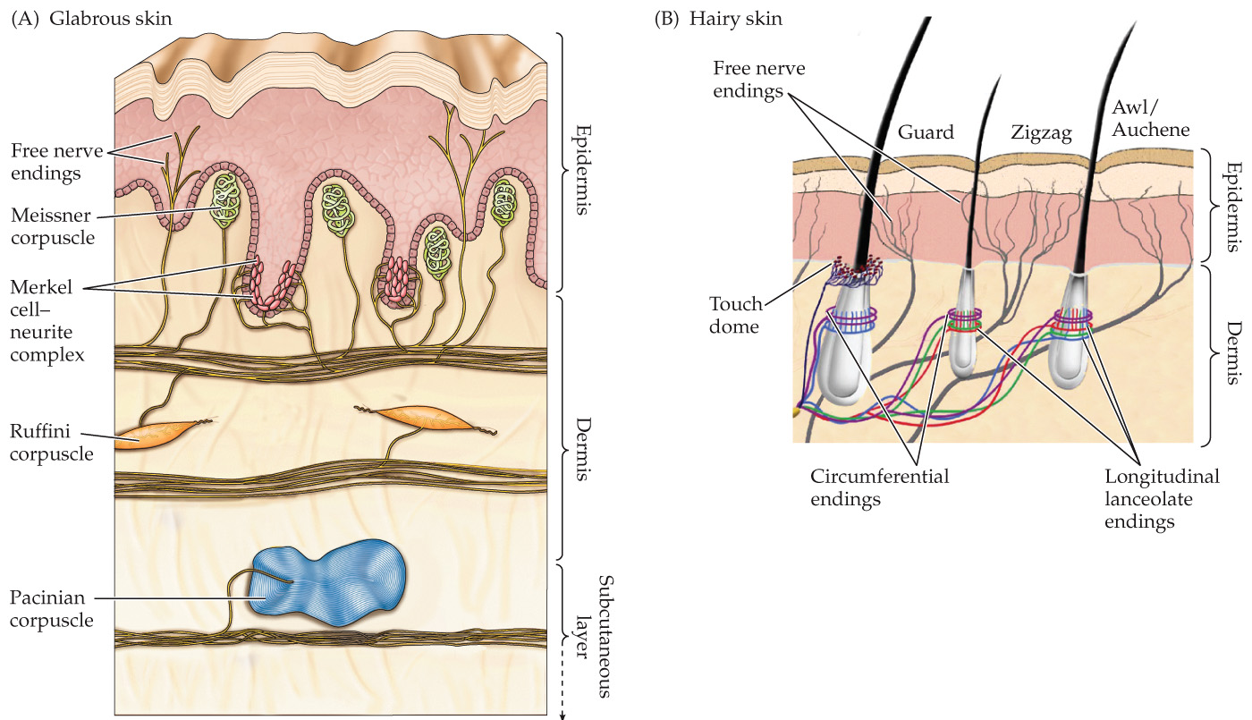
Skin is the sensory organ for touch
Mechanical manipulation of receptors produces receptor potentials in touch sensory neurons.
Free nerve endings: pain and temperature
Merkel cells: fine touch
Meissner’s corpuscles: motion and grip
Hair follicles: touch
Pacinian corpuscles: vibration and pressure
Ruffini’s corpuscles: stretch

Slide 7
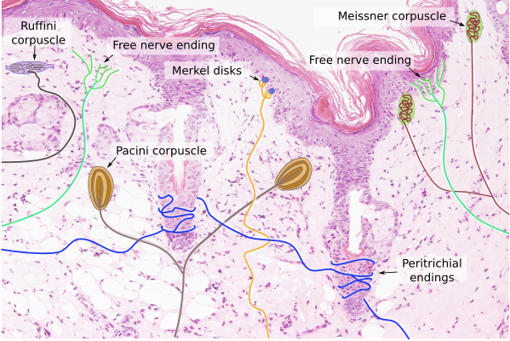

Slide 8
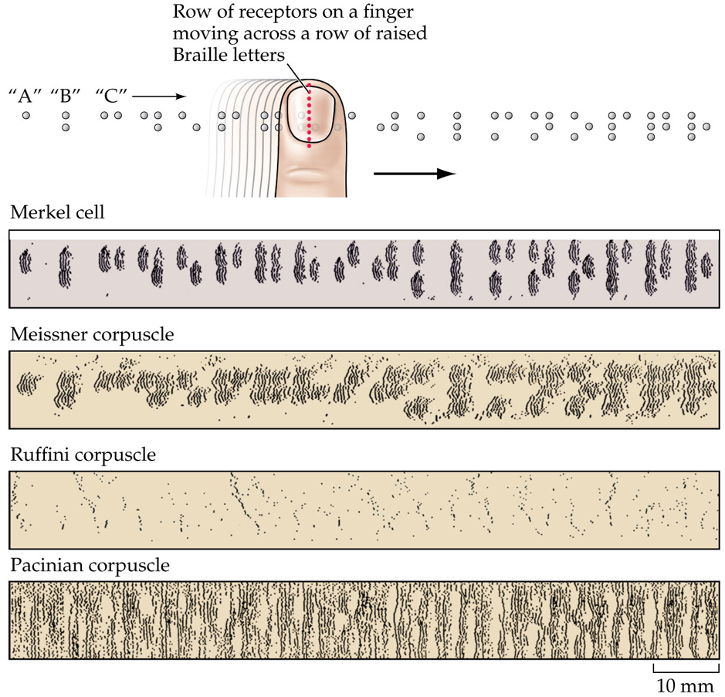

Slide 9
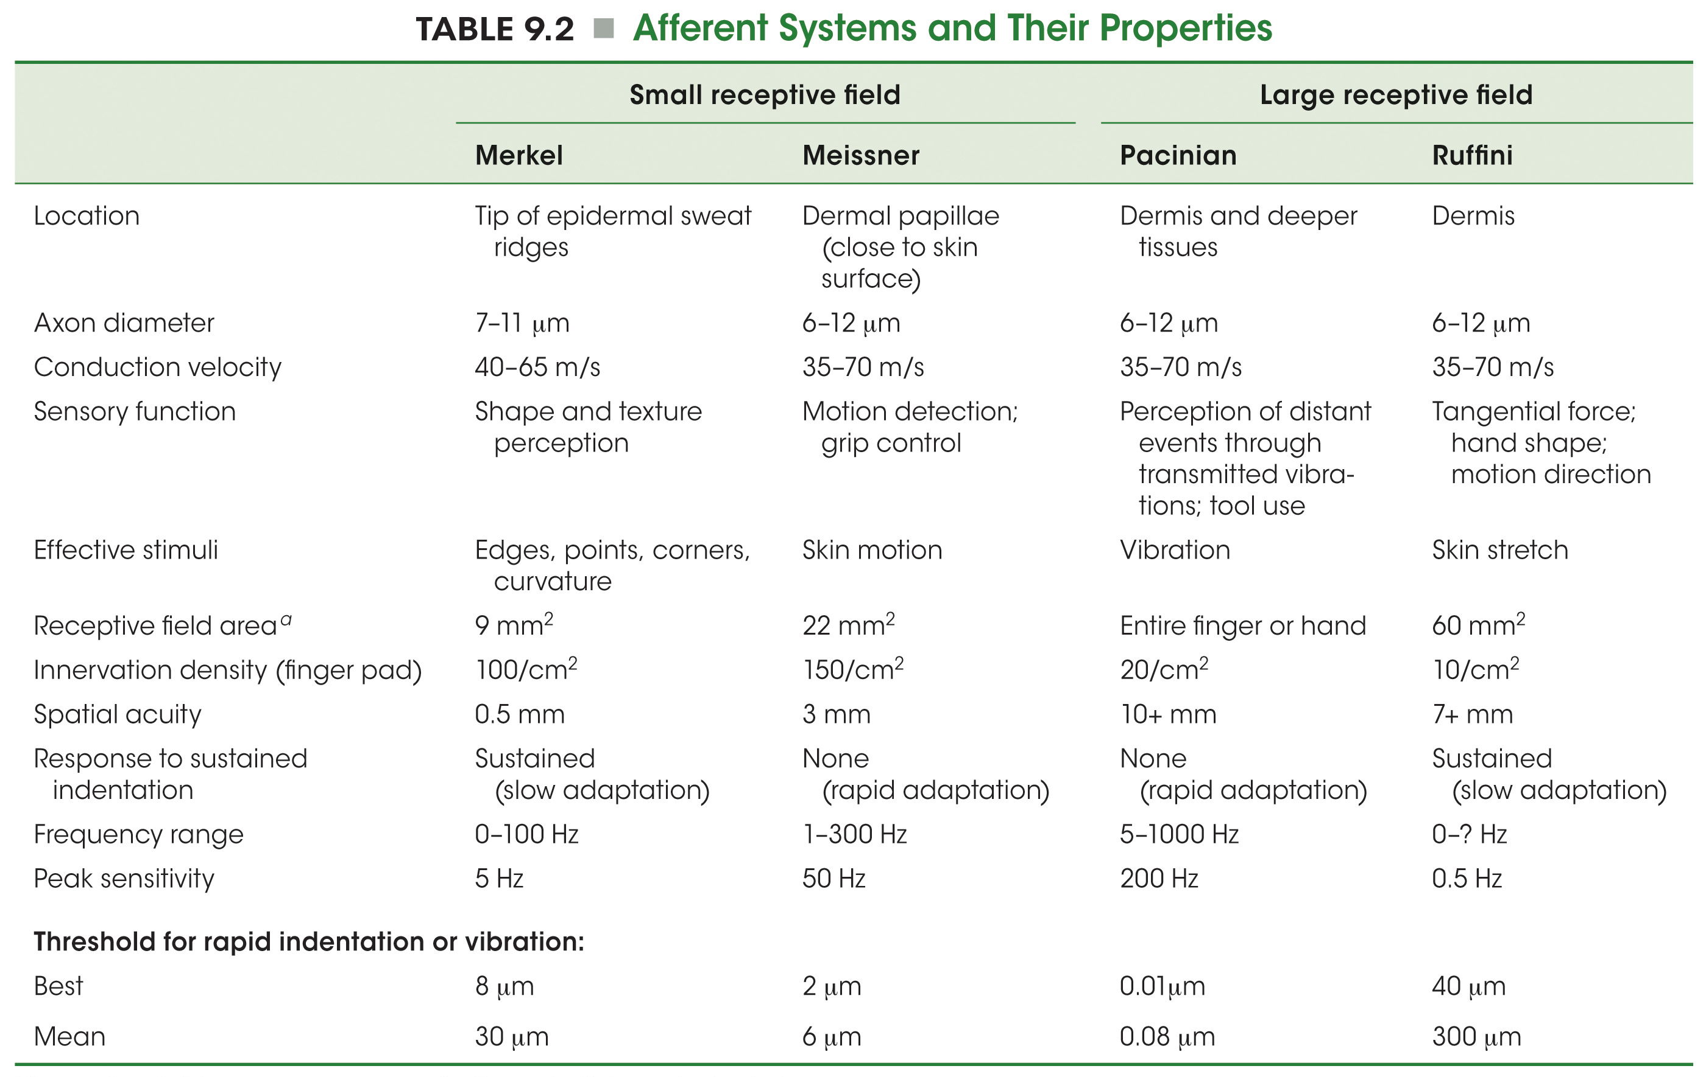

Slide 10
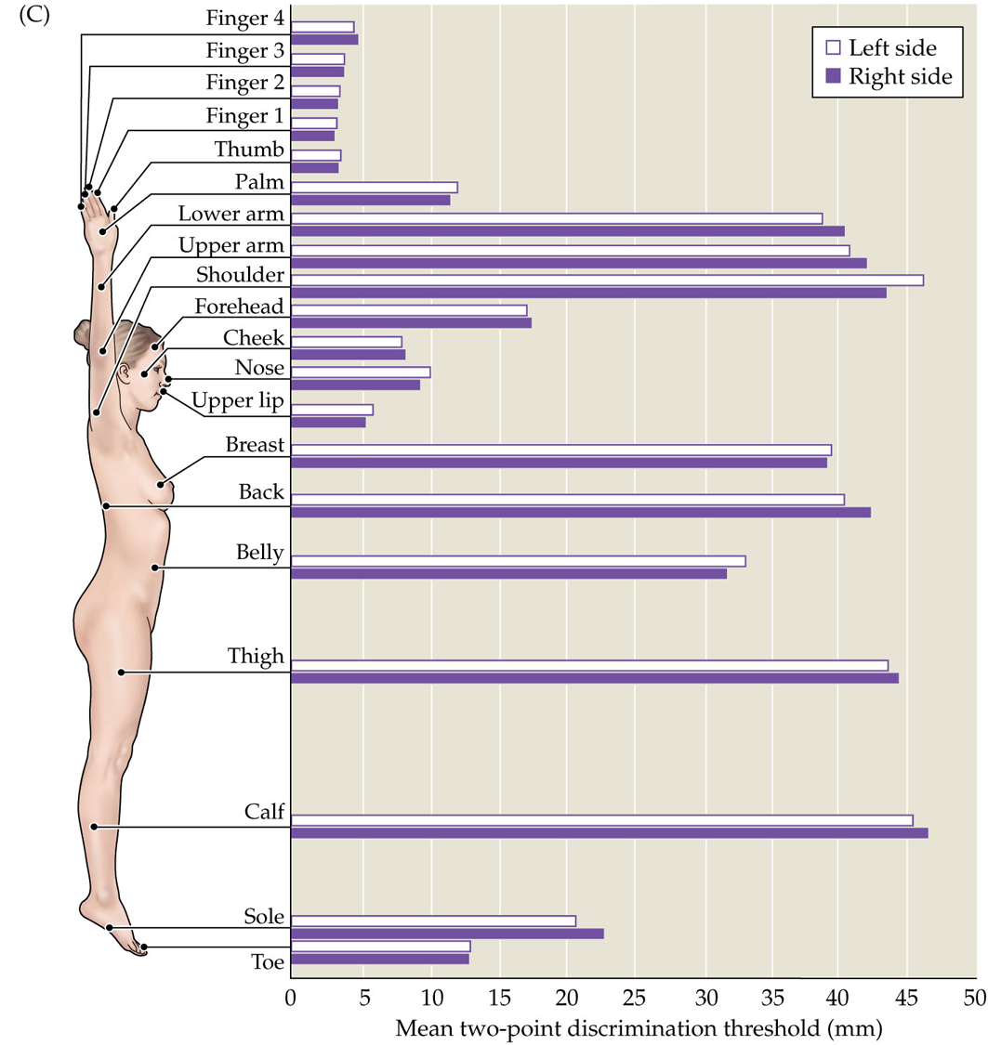
Receptor Fields
The region of a receptive surface within which a specific stimulus elicits the greatest firing rate from a sensory cell.
The size of a receptor field is highly variable.
The larger the receptive field, the less spatial acuity.
  2-point discrimination

Slide 11
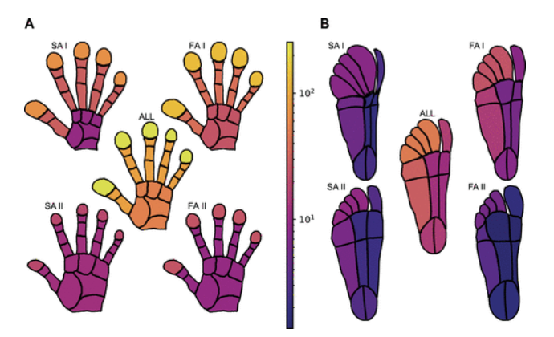
Innervation Densities
Concentration of nerve fibers in a specific area.
  High=many nerves
    More sensitive
  Low= not many nerves
    Less sensitive

Slide 12
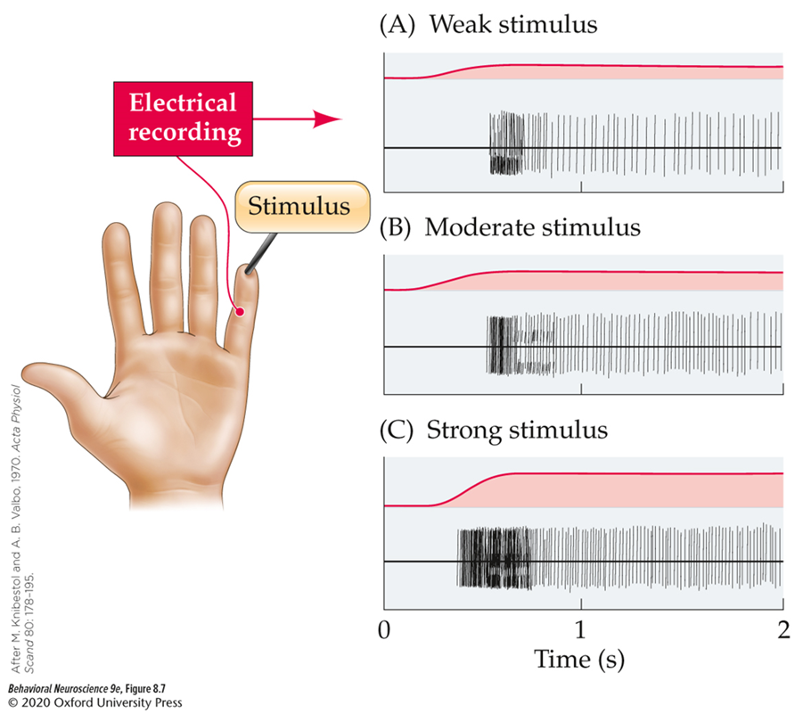
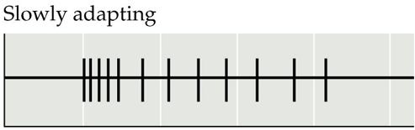
Sensory Adaptation
Progressive loss of response to a constant stimulus.
Rapidly adapting receptors (aka phasic) initially show a response to a stimulus, but quickly go through adaptation.
  Meisner's & Pacinian corpuscles
Slowly adapting receptors (aka tonic) sustain activity in response to a stimulus.
  Merkel cells & Ruffini corpuscles

Slide 13
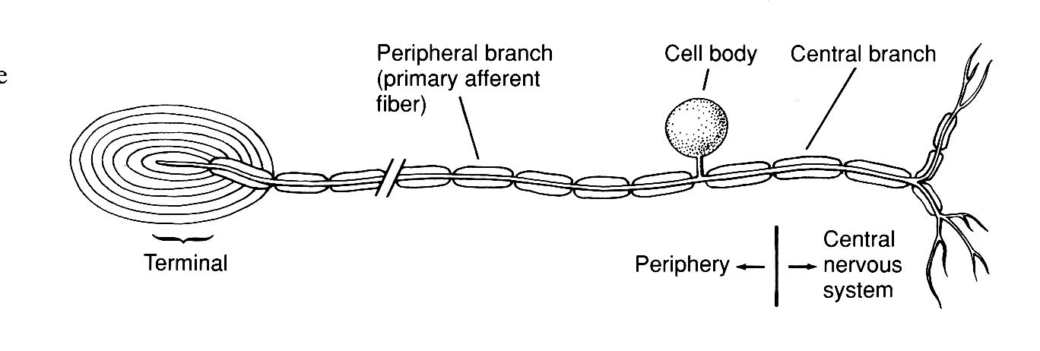
Sensory receptors are associated with a specific primary afferent
Dorsal root ganglion (DRG)
Sensory receptors are here

Slide 14
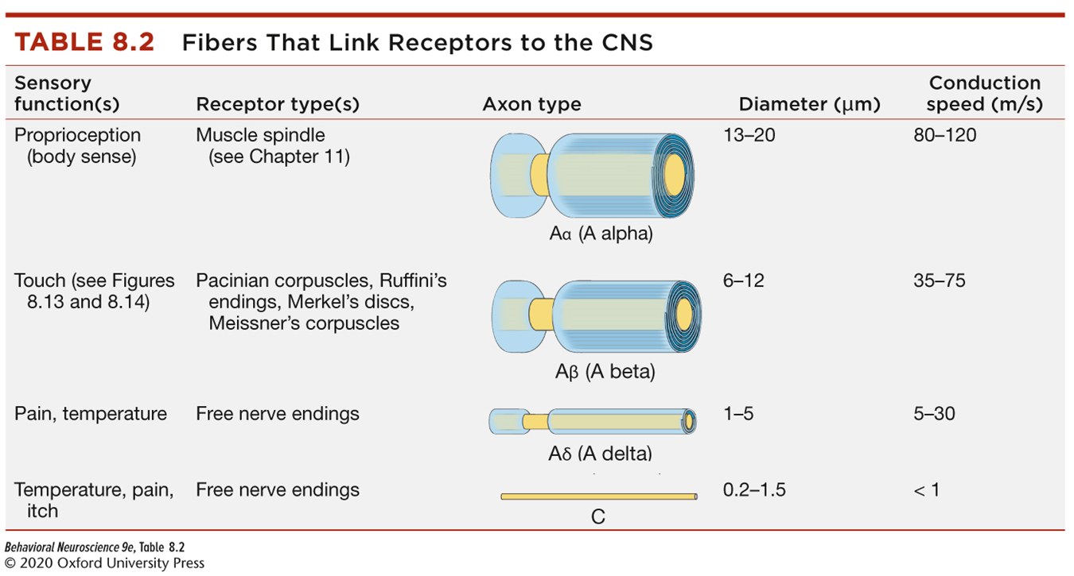
Primary afferents differ in myelination & axon diameter

Slide 15
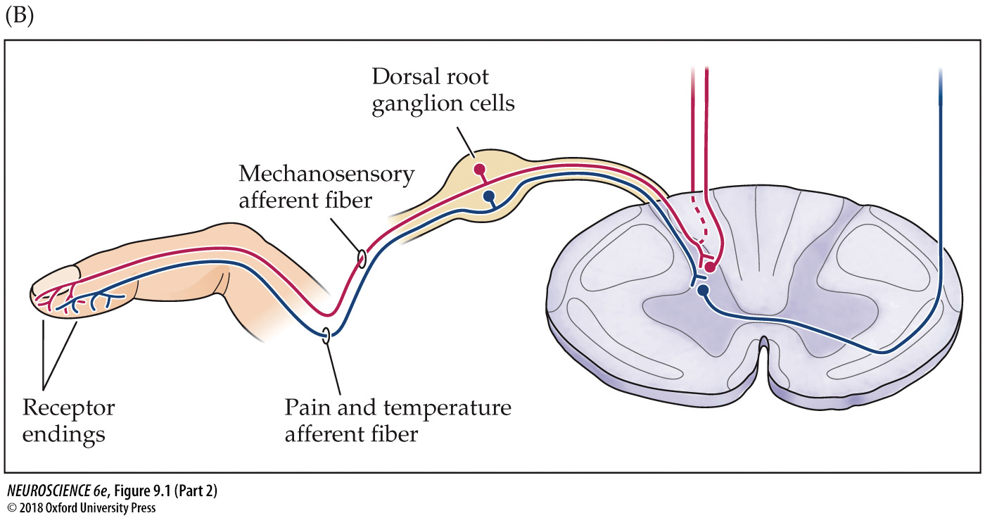
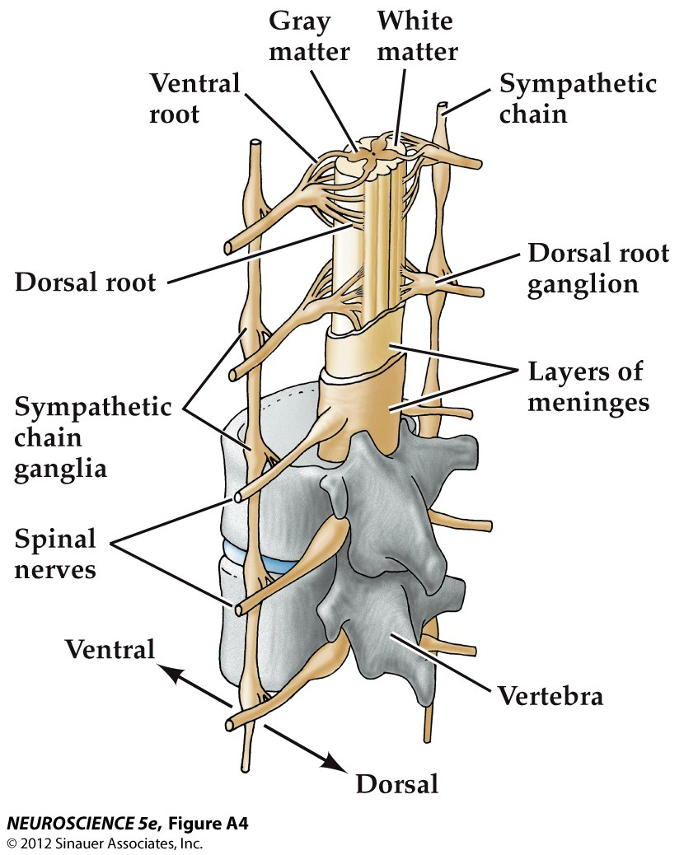
Afferents convey information to the CNS

Slide 16
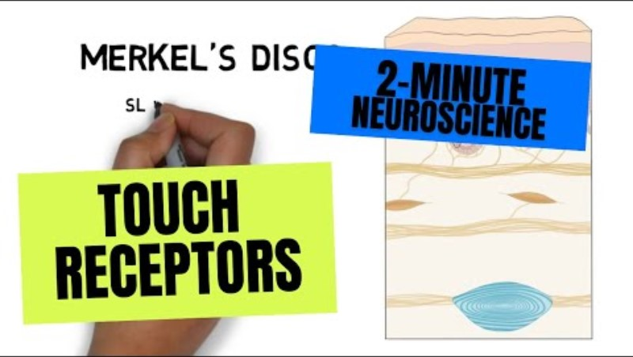
2 Minute Neuroscience:
Touch Receptors

